Slide 1

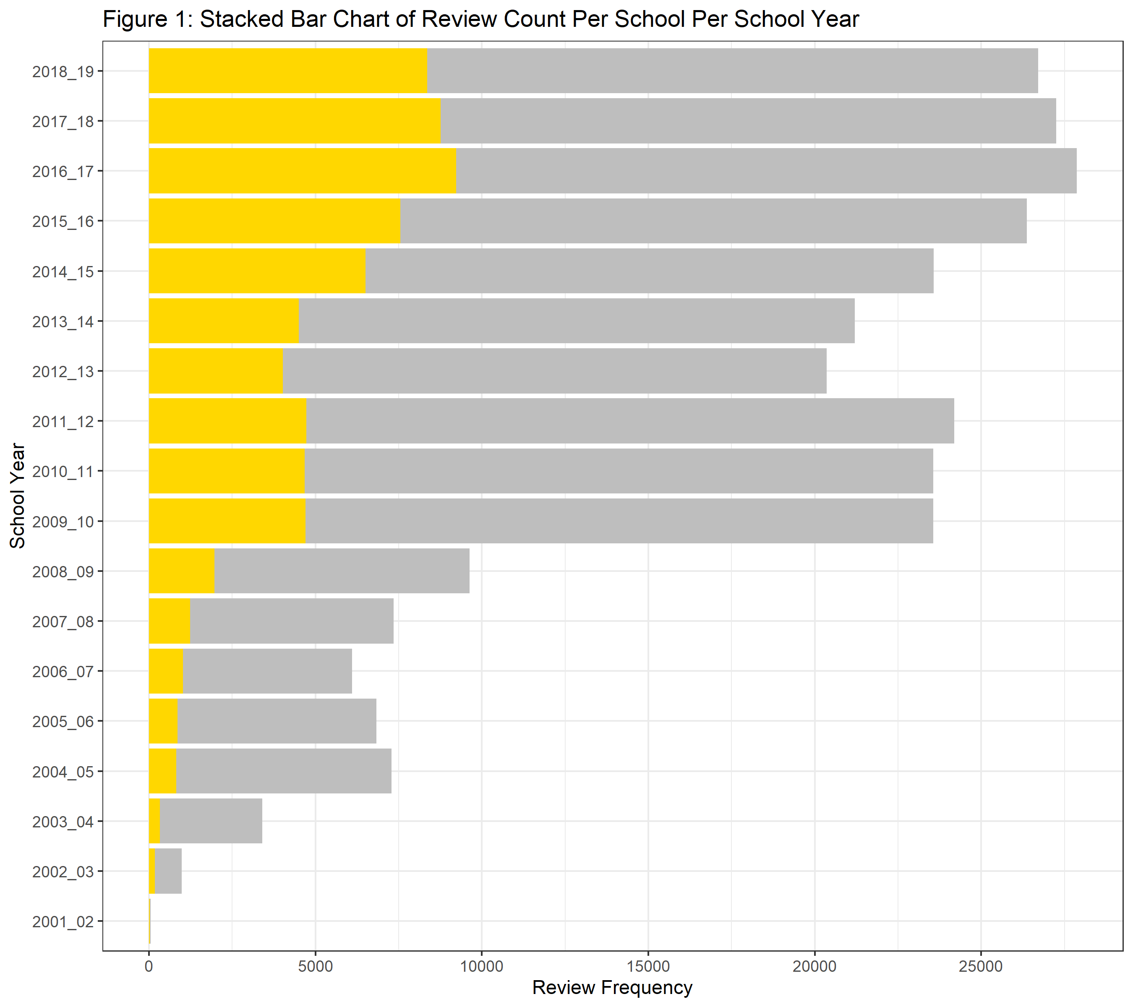
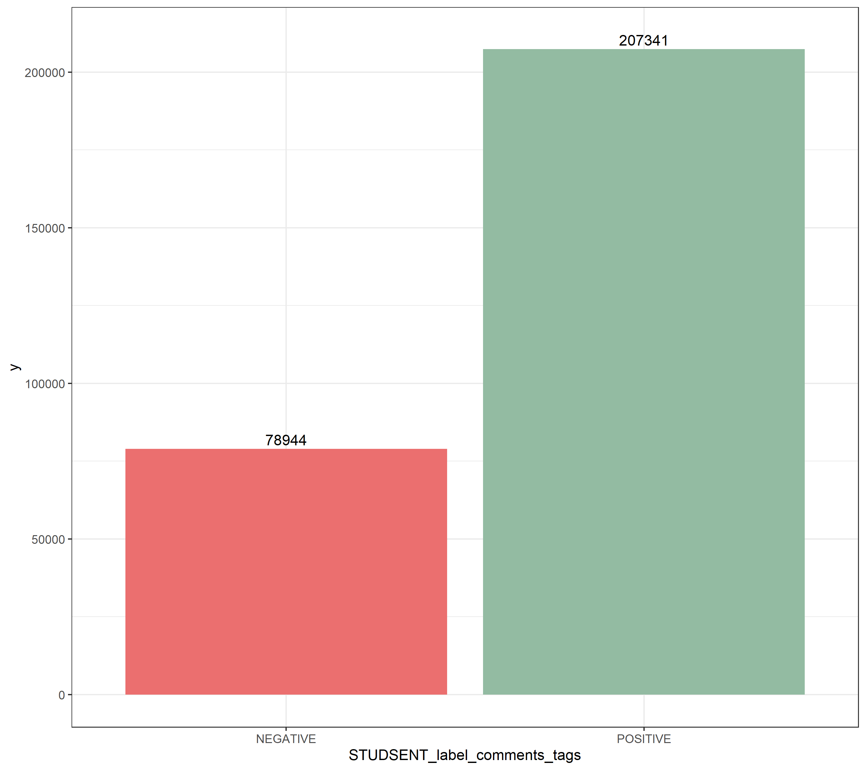
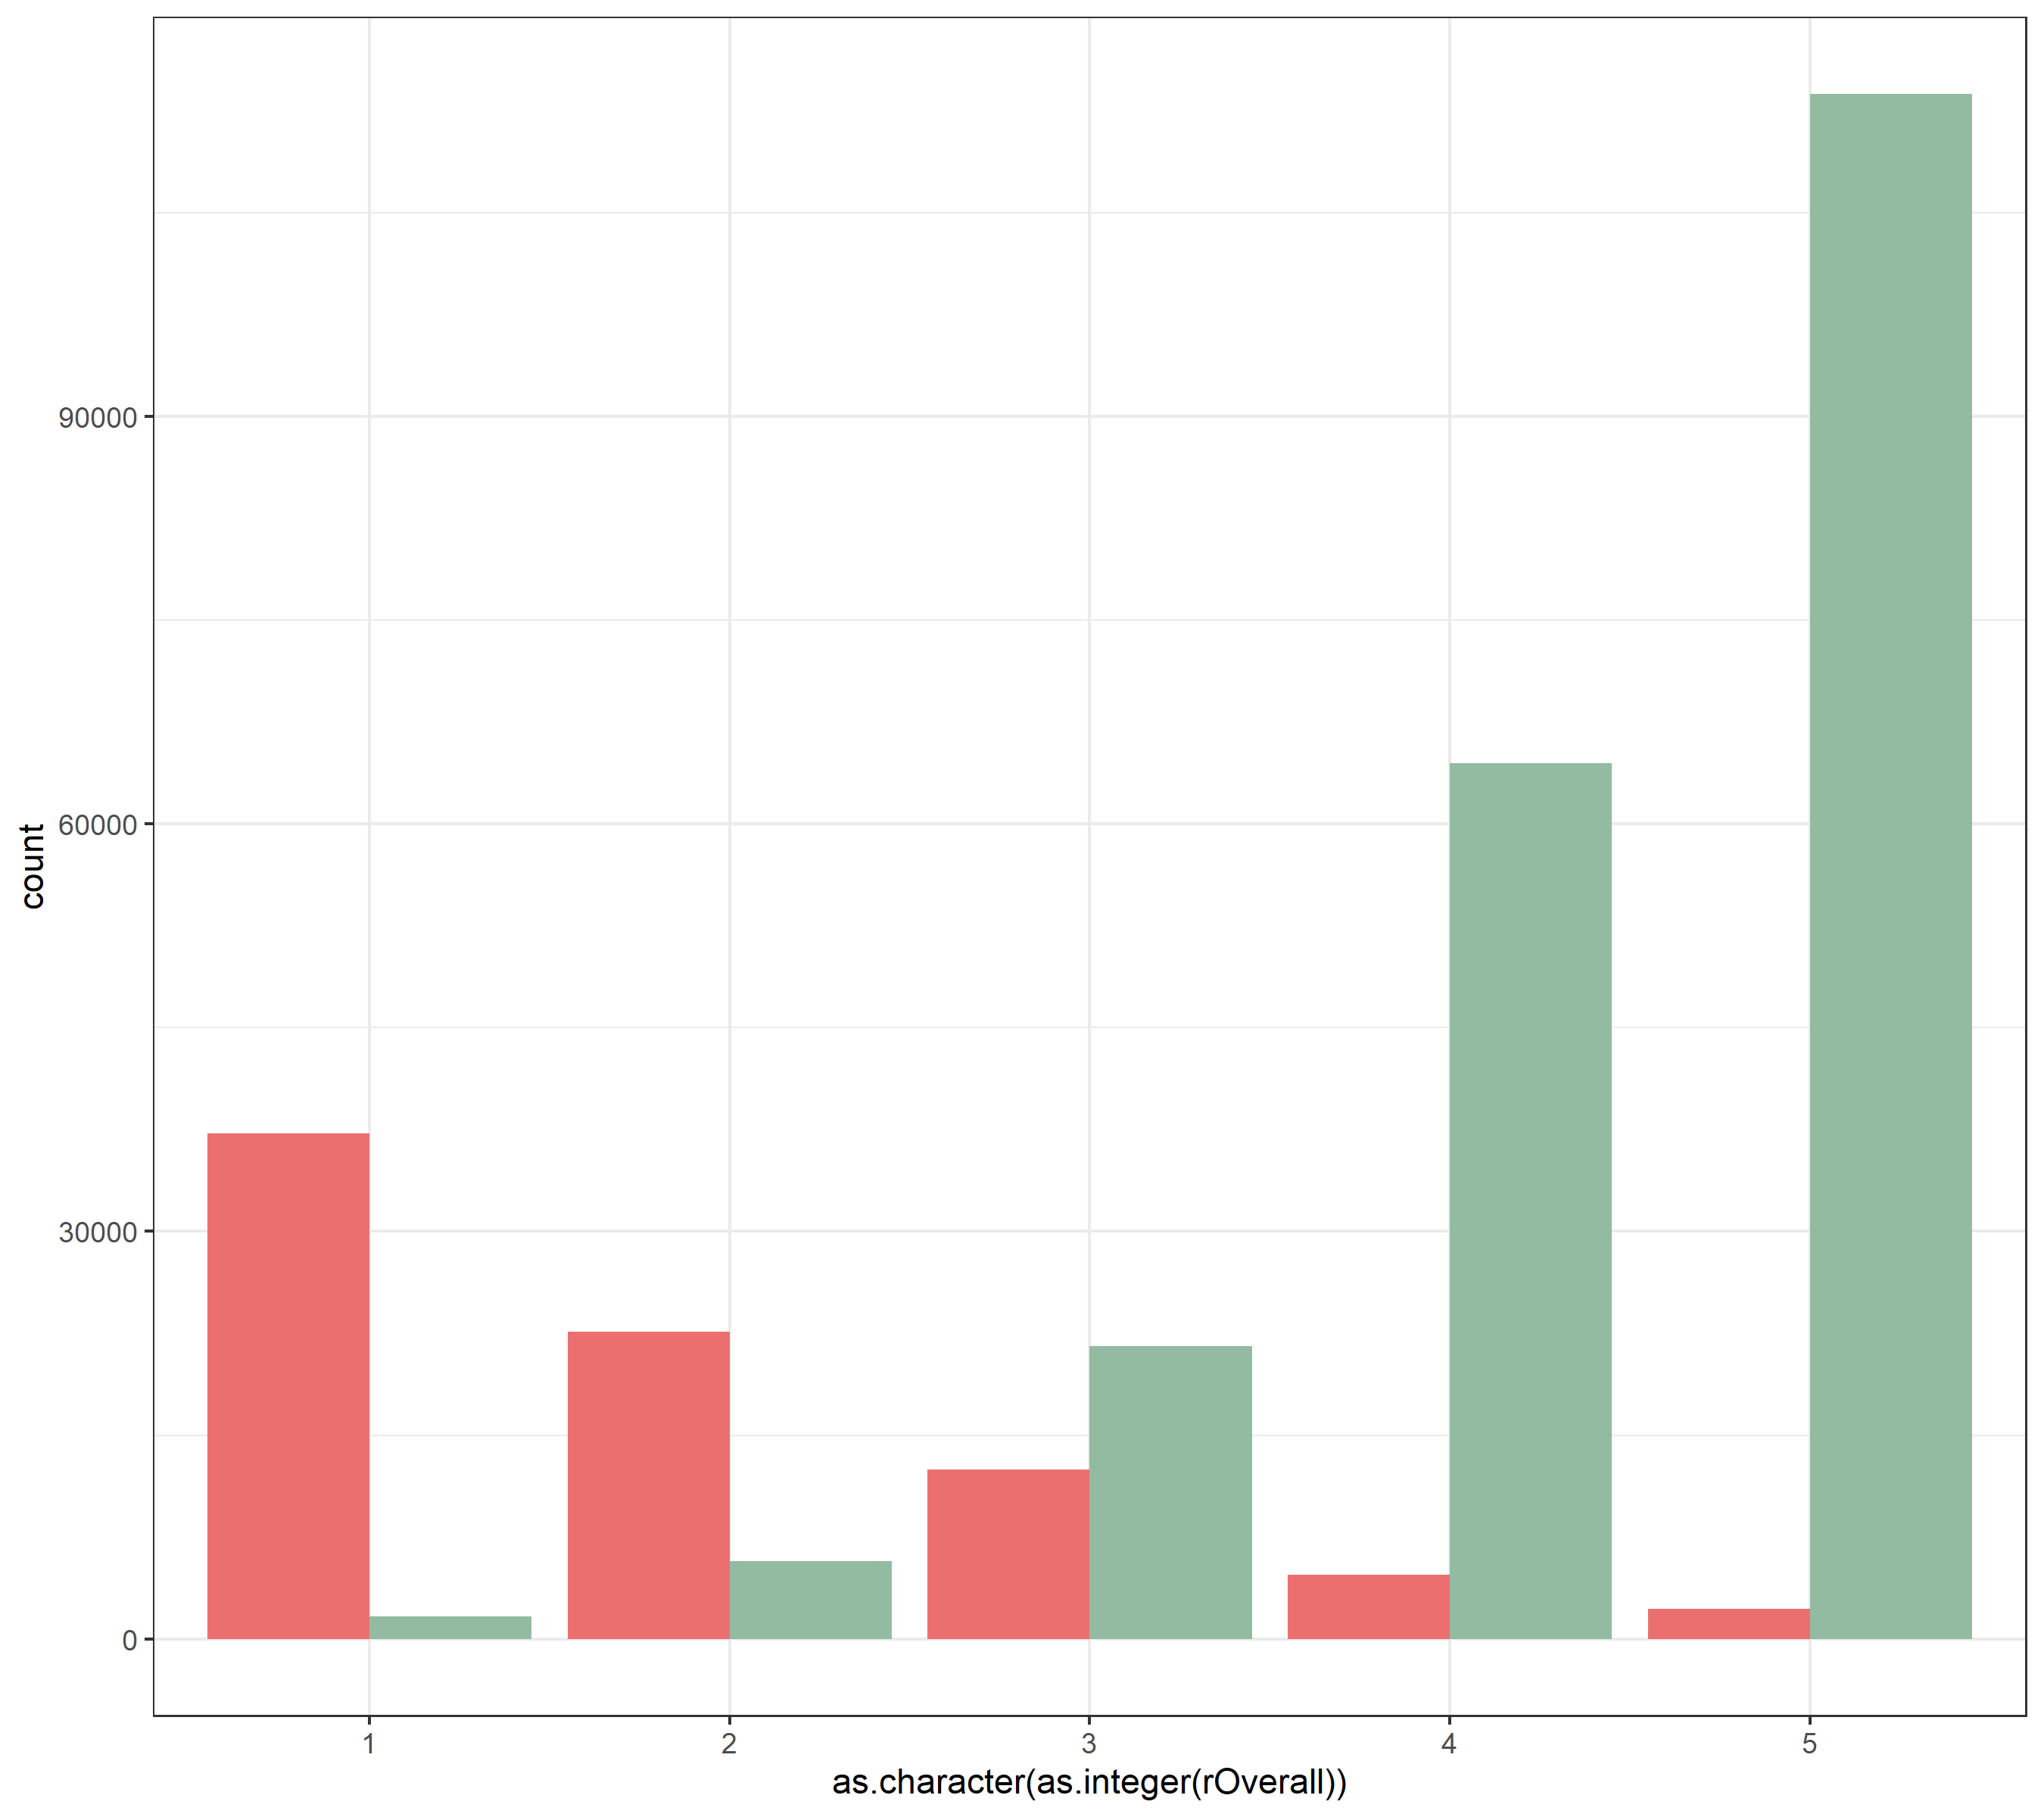
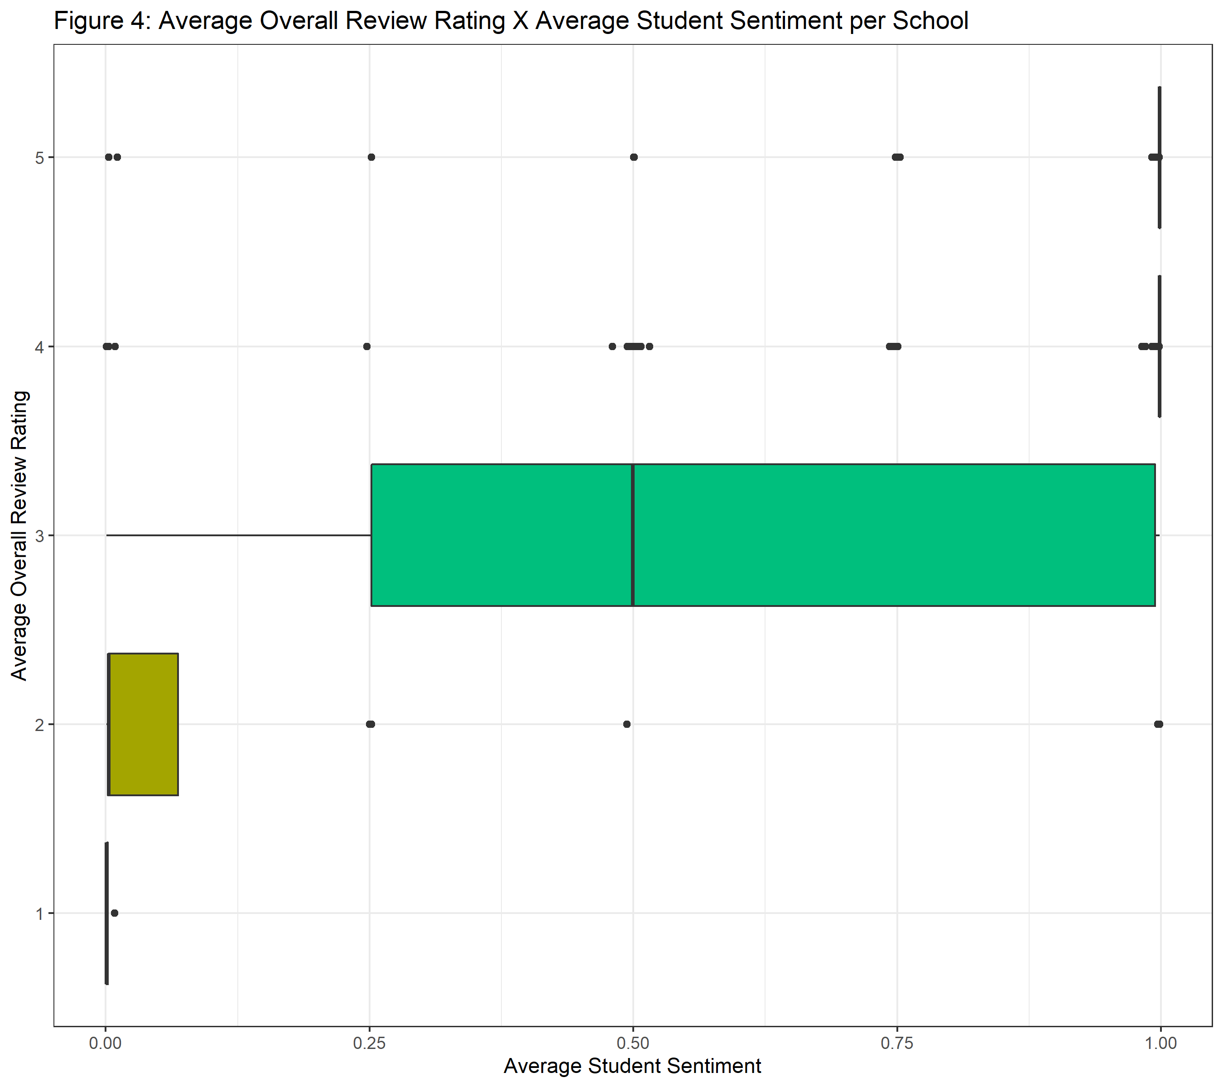
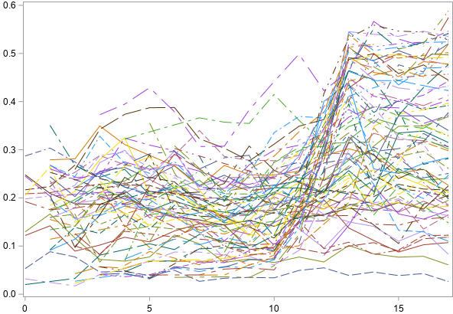
Title Nathaniel Jones
Faculty Advisors:
INTRODUCTION
METHODS
The goal of this research is to study the change in the two-year withdrawal rate at post-secondary schools. To do this, data was scraped from Rate My Professor and merged with the CollegeScorecard dataset to determine which post-secondary schools have a positive or negative average student sentiment. Generalized Linear Model was be used to model the two-year withdrawal rate over time.
To measure student sentiment, a pretrained language model was used on the comments and tags left by students on Rate My Professor to gauge positive or negative sentiment. Average student sentiment was aggregated across each school for each school year. The two-year withdrawal rate was modelled using the school year and average student sentiment for each school.
Data Collection: The data collection process utilized a GitHub repository under the name ‘ratemyprof-api’ that returns all professor review data for a given school’s SID. Since a school’s SID is assigned by Rate My Professor and is not in the CollegeScorecard dataset, the SID’s must be collected for each school. Python packages Requests and BeautifulSoup were used to search Rate My Professor for the school’s URL directory and collect 3,988 SID’s.
Data Wrangling: Due to the number of reviews Rate My Professor has for each school, this project will focus on post-secondary schools in Georgia where the highest degree offered is either a bachelor’s or a graduate degree. Some schools have very few reviews or only have reviews for one or two school years. Since a longitudinal model will be constructed from this data, these schools were dropped from the dataset. Lastly, the school years prior to 2001-2002 contain little to no data and were not used in this project. After filtering the data in this way 286,288 reviews remained for 97 Georgia schools over 18 school years (2001-2002 to 2018-2019).
BERT: Bidirectional Encoder Representations from Transformers or BERT is a transformer-based machine learning technique used in natural language processing. A pretrained language model, such as ‘siebert/sentiment-roberta-large-English’, can be used in Hugging Face’s transformer pipeline for many natural language processing tasks, including sentiment analysis.
Sentiment Analysis: Sentiment analysis is a natural language processing technique to systematically identify the positive or negative emotional polarity of a given text. It is also known as opinion mining and is typically used to gain insight into consumer reviews of a product. This project used a pretrained language model on the comments left by student reviewers on Rate My Professor and then aggregated the sentiment score, a value between 0 (Negative) and 1 (POSITIVE), for each school with the median.
Longitudinal Analysis: Longitudinal data analysis seeks to partition the variance into time-invariant and time-variant pieces with a Multi-Level Model structure. This research project used a 2-level model where the level two unit of observation is schools, and the level one unit of observation is school year.
CollegeScorecard: For this research project, the following 4 parameters were used:
INSTNM: The name of the school.
SCHOOL_YEAR: The school year (EX: 2020-2021)
WDRAW_ORIG_YR2_RT: The two-year withdrawal rate for students that original began at the institution they withdrew from.
Rate My Professor: Following 6 parameters were used:
REVIEW_IDs: Three ID variables identify distinct schools (SID),
professors (TID), and review instances (RID).
DATE: The month-day-year of the review.
OVERALL: A overall rating (1-5) given by the reviewer.
COMMENTS: The reviewers' comments on the course.
CONCLUSIONS
RESULTS
Review Count Per School (Figure 1): Figure 1 displays the frequency of reviews over time. The total number of reviews is displayed by the grey bar. The gold bars layered on top of the grey bars are reviews from KSU.
Review Sentiment Count (Figure 2): Figure 2 displays the results of the sentiment analysis on the review comments, which labelled 78,944 reviews as ‘Negative’ (red) and 207,341 reviews as ‘Positive’ (Green). To verify the results, a comparison was made between the overall ratings, the sentiment labels, and the count of reviews.
Review Sentiment Count X Overall Review Rating (Figure 3): Figure 3 displays the frequency of ‘Positive’ or ‘Negative’ reviews stratified by the overall review ratings. Plotted in green are reviews labelled ‘Positive’ while ‘Negative’ reviews are in red. From this plot, reviews given an overall rating of 3 or more typically have a comment with ‘Positive’ sentiment while reviews with ratings less than 3 typically have a negative sentiment.
Average Overall Rating X Average Student Sentiment per School (Figure 4): Figure 4 displays the results of aggregating both the sentiment of the review and the review’s overall rating to their respective medians for each school. These boxplots show the median student sentiment stratified over the average overall rating per school
Spaghetti Plot of the Two-Year Withdrawal Rate (Figure 5): Figure 5 displays the two-year withdrawal rate over time. On the horizontal axis, zero represents the earliest school year in the data (2001-2002) and each unit increase is the number of school years past the earliest school year Each line is the trajectory of an individual's school's withdrawal rate.
Residual Plot (Figure 6): This is where it will continue …
Figure 1 : Frequency of Reviews over Time
Figure 2: Frequency of Positive and Negative Sentiment
Figure 3: Frequency of Positive and Negative Sentiment stratified by Overall Rating
School Year
Review Frequency
Review Frequency
Figure 6:
Review Frequency
Student Sentiment Label
Overall Review Rating
Figure :
Figure :
Figure 4: Boxplot of the School’s Median Student Sentiment stratified by the Median Overall Rating
Figure 5: Spaghetti Plot of the Two-Year Withdrawal Rate
Median Overall Rating
Two-Year Withdrawal Rate
CODE SNIPPET
This is where I will continue ...
Median Student Sentiment
School Years Since the Earliest School Year (2001-2002)

